Slide 1

Realistic Re-evaluation of Knowledge Graph Completion Methods: An Experimental Study
Farahnaz Akrami¹, Mohammed Samiul Saeef¹, Qingheng Zhang², Wei Hu², Chengkai Li¹
1-University of Texas at Arlington, 2-Nanjing University
Farahnaz Akrami
Notes:
Hello, I am Farahnaz Akrami, PhD student from the University of ‘Texas at Arlington.

Slide 2

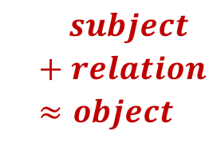
Embedding Models in Link Prediction
Learned Vectors
Training Data
Steven Spielberg
subject
relation
object
director
$subject$
$$+ relation$$
$$≈object$$
James Cameron
Jurassic Park
(Steven Spielberg, director, Jurassic Park)
(Jurassic Park , genre, Adventure)
(James Cameron , writer, Avatar)
.
.
.
director
Model Training
Avatar
Test Data
Ranked Predictions
?
James Cameron
Steven Spielberg
.
.
.
( James Cameron , director, Avatar)
Notes:
Our paper is an e(i)m’pirical study of the evaluation of popular embedding models for knowledge graph completion particularly for the task of link prediction. Embedding models learn vector representations of entities from known data in the form of <subject, relation, object> triples. These models embed each entity into a multi-dimensional vector. In TransE, which is perhaps the most well-known embedding model, a relation is also a vector, which represents a geometric transformation between the subject and object entities in the embedding space. The vectors are learned in a way such that, for a training triple, the summation of the vectors of the subject entity and the relation are as close to the object entity’s vector as possible.
In evaluating TransE, given a test triple, the task is to pretend either the subject or the object entity is missing, and then use the learned vectors to rank all candidate entities based on how much these vectors deviate from the premise that subject vector plus relation vector equals object vector.

Slide 3
Evaluation of Embedding Models
Model | Year | Performance | Citation
TransE | 2013 | 47.1 | 2053
TransH | 2014 | 58.5 | 1036
DistMult | 2015 | 57.7 | 578
TransR | 2015 | 65.5 | 1120
TransD | 2015 | 74.2 | 452
DKRL | 2016 | 57.6 | 245
HoLE | 2016 | 73.9 | 431
TranSparse | 2016 | 78.3 | 177
ComplEx | 2016 | 84.0 | 468
R-GCN | 2017 | 84.2 | 494
ANALOGY | 2017 | 85.4 | 107
ProjE | 2017 | 88.4 | 117
ConvE | 2018 | 87.3 | 297
RotatE | 2019 | 88.4 | 89
TuckER | 2019 | 89.2 | 34
Evaluation metrics
MR, FMR
Hits@k, FHits@k
MRR, FMRR
Datasets
FB15k, FB15k-237
WN18, WN18RR
YAGO3-10, YAGO3-10-DR
Notes:
Embedding models for knowledge graph completion has been a popular subject of study. This table shows how some of the most well-known models made progress on prediction accuracy over the years. For evaluation of accuracy, these studies used various metrics such as Mean Rank and Hits. Several benchmark datasets are commonly used for evaluation. This talk will focus on FB15k and FB15k-237 which are subgraphs of Freebase. The paper has details about similar observations and results using other datasets.

Slide 4
Findings from Our Re-Evaluation of the Models
Current link prediction methods do not work
Problems of the datasets substantially inflated the accuracy of these models.
Reverse relations
Duplicate relations
Cartesian product relations
Given the problematic data, very simple rules can challenge the accuracy of these complex machine learning models.
The true accuracy of these models is very poor on realistic data.
The link prediction task on the problematic datasets is nonexistent in the real-world.
Notes:
When we started to investigate these models a couple of years ago, we soon noticed some problems with the benchmark datasets. We thus decided to thoroughly re-evaluate these models. Our findings are first various problems of the benchmark datasets led to unrealistic inflation of the models’ accuracy. Second, given the problematic data, very simple rules can challenge the accuracy of those complex machine learning models. Third, the true accuracy of the models is poor on realistic data. Finally, the link prediction task on the problematic dataset is nonexistent in the real-world.

Slide 5
FB15k Contains Many Pairs of Reverse Triples
70% of training triples are reverse of each other
70% of test triples have their reverse available in training set
Training set of FB15k
Test set of FB15k
Steven Spielberg
?
directed_by
Jurassic Park
Steven Spielberg
director
(Steven Spielberg, director, Jurassic Park )
(Jurassic Park, directed_by, Steven Spielberg)
(Steven Spielberg, director, The Terminal)
(The Terminal, directed_by, Steven Spielberg)
director
directed_by
director
directed_by
Schindler's List
Schindler's List
(h, director, t)⇒(t, directed_by, h)
The Terminal
Notes:
The first problem is that FB15k has excessively many reverse triples. In the graph on this slide, there are two reverse triples about the same relationship between Steven Spielberg and Jurassic Park, which are depicted by the two reverse edges.
70% of the triples in FB15k’s training set form reverse pairs. Therefore, the embedding models could largely be just learning whether two relations form a reverse pair, for example, directed_by and director.
Similarly, for 70% of the test triples, their reverse triples exist in the training set. For instance, the training data say Shindler’s List is directed by Steven Spielberg. After the embedding model essentially learned directed_by and director are reverse, it becomes trivial to predict who is the director of Shindler’s List.

Slide 6
On Fb15k Very Simple Rules Can Challenge the Accuracy of Complex Machine Learning Models
Model | Hits@1
TransE (2013) | 26.9
ComplEx (2016) | 59.5
ConvE (2018) | 60.7
RotatE (2019) | 73.8
TuckER (2109) | 72.5
Simple Model | 71.6
(h, r₁, t)⇒(t, r₂, h)
Notes:
We used a simple rule to find reverse relations—if the subject/object pairs of two relations have 80% overlap, we consider them reverse. We then used the derived reverse relations to do link prediction. The accuracy of this extremely simple model is on par with the state-of-the-art complex machine learning models.

Slide 7
The Link Prediction Scenario on such Data Is Non-Existent in the Real-World
Steven Spielberg
Jurassic Park
director
directed_by
director
reverse_property
directed_by
Notes:
The link prediction sce’nario, given such excessive reverse triples, is non-existent in the real-world. In Freebase, which was used to produce FB15k, when a new fact is inserted, it would be added as a pair of reverse triples. The relations of the two reverse triples are denoted explicitly by a special relation in Freebase called reverse_property.
Therefore, there is never a scenario in which one needs to predict a triple while its reverse is already in Freebase. Training a link prediction model using FB15k is thus a form of overfitting in that the learned model is optimized for the reverse triples which cannot be generalized to realistic settings. More pre’cisely, this is a case of excessive data leakage—the model is trained using features that otherwise would not be available when the model is applied for real prediction.

Slide 8
Out of 1345 Relations in FB15k, 168 Are Duplicate Relations
Freebase
team
goals
year
football_roster_position/
player
sports_position/
players
player
position
CVT
footbal_position/players
FB15k
football_roster_position/player. sports_position/players
(2)
player
position
(1)
football_position/players
Notes:
These benchmark datasets have another type of data redundancy that unrealistically inflates the models’ accuracy. They have duplicate relations, in which the subject-object pairs substantially overlap.
Duplicate relations in FB15k come from Freebase, part’icula(e)rly due to the concatenation of edges on a special type of nodes called CVT nodes which represent multiary relationships. In this example, relation number (1) in red color records football player’s position considering their overall career. Relation number (2) in green color is a concatenation of two edges connected through a CVT node, representing a multiary relationship about the position a player plays for a team. Since most players play at the same position throughout their careers, these two relations are highly redundant and we call them duplicate relations.
In FB15k, all CVT nodes and their edges are removed, but the concatenated edges are kept. Out of the 1345 relations in FB15k, 168 relations form duplicate pairs. Similar to the case of reverse relations, on these duplicate relations, very simple rules can be as accurate as the embedding models.

Slide 9
In FB15k, 142 out of the 1345 Relations Are Cartesian Product Relations
Original triples in Freebase
Concatenated triples in FB15k
Tokyo
Tokyo
January
January
climate.month
climate
CVT
month
Dallas
February
average_min_temp
average_max_temp
rain_fall
Berlin
December
34
49
1.9
The link prediction (whether a city has a climate in a month) is meaningless in the real-world.
Simple method: If bipartite graph of a relation is almost complete, it is a Cartesian product relation; missing links in the complete bipartite graph are predicted to be true.
On all 9 Cartesian product relations in FB15k , this simple model has an average FHits@10↑ of 98.3% which is higher than the 96.3% FHits@10↑ of TransE.
Notes:
We also discovered another problem due to concatenated edges around CVT nodes which led to overestimated accuracy of embedding models. This problem shows up in what we call the Cartesian product relations. The subject-object pairs from all instance triples of such a relation form a Cartesian product.
In this example, Tokyo and January are connected through a CVT node, with two edges labelled climate and month. The same CVT node also connects to nodes that represent the average minimum and maximum temperature and rainfall of Tokyo in January. The concatenated edges labelled climate.month thus form the Carterisan product relation which records the obvious fact that every city has a climate in every month. The link prediction scenario of predicting whether a city has a climate in a month is meaningless in the real-world.
Our paper shows that a very simple method can be more accurate than TransE on Cartesian product relations. We can view a relation as a bipartite graph between its subjects and objects. The simple method declares a relation to be a Cartersian product if the graph is close to a complete bipartitie graph based on a threshold. For link prediction, the simple method just considers every edge in the complete bipartitie graph to be true.

Slide 10
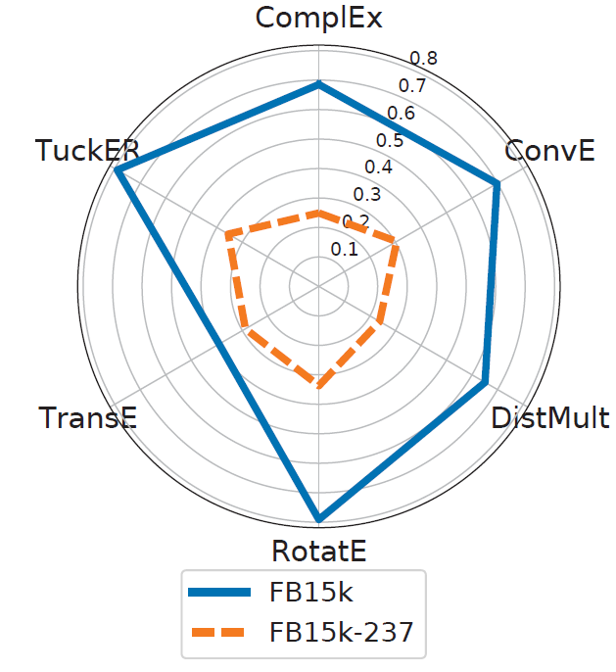
Performance of Embedding Models on Datasets without Data Redundancy
Findings: Current Link Prediction Methods Do Not Work
Problems of the datasets substantially inflated the accuracy of these models.
Given the problematic data, very simple rules can challenge the accuracy of these complex machine learning models.
The true accuracy of these models is very poor on realistic data.
The link prediction task on the problematic datasets is nonexistent in the real-world.
Notes:
Earlier in the talk I provided a list of our findings, as shown here again. I already explained points #2 and #4 of this list.
Regarding points #1 and #3, we did experiments to find out the true accuracy of the embedding models, using a dataset with less of the aforementioned problems. One such dataset is FB15k-237, which is a subset of FB15k where most reverse and duplicate relations are removed.
By comparing the models’ accuracy on both FB15k and FB15k-237, we verified point #1: the performance of all methods worsens considerably after removal of reverse and duplicate relations.
We also verified point #3, as the absolute accuracy of all models is poor on the more realistic dataset FB15k-237. This shows that existing models are ineffective for real-world link prediction tasks

Slide 11
Similar or Even Worse Performance of Many Successors of TransE on Datasets without Data Redundancy
Model | TransE (2013) | ComplEx (2016) | ConvE (2018) | RotatE (2019) | TuckER (2109)
FMRR(FB15k) | 0.392 | 0.685 | 0.698 | 0.791 | 0.790
FMRR(FB15k-237) | 0.288 | 0.249 | 0.305 | 0.337 | 0.355
Percentages of test triples, on which various models outperformed TransE, that have reverse and duplicate triples in training set
Model | ComplEx (2016) | ConvE (2018) | RotatE (2019) | TuckER (2109)
FB15k | 84.67 % | 78.04 % | 78.16% | 78.87%
Notes:
Another observation is that many successors of TransE that outperformed TransE on FB15k attained similar or even worse performance on FB15k-237.
We hypothesize that these models improved mostly on reverse and duplicate triples and hence, after removing those triples, they do not exhibit clear advantage.
Our findings verified this hypothesis. We looked at the test triples on which these models outperformed TransE. It turns out a large percentage of such triples have reverse or duplicate triples in the training set. For instance, the percentage is 78% for ConvE.

Slide 12
Related Work
[Toutanova and Chen, 2015]
Detected the reverse relation problem in FB15k and generated FB15k-237
[Dettmers et al., 2018]
Detected the reverse relation problem in WN18 and generated WN18RR
[Meilicke et al., 2018]
Analysis of the types of rules that help knowledge graph completion
[Akrami et al. 2018]
Reevaluation of embedding models
[Wang et al., 2019]
Analysis of existing evaluation methods
This paper for the first time
Conducts a systematic study with the main objective of assessing the true effectiveness of embedding models when the unrealistic triples are removed
Provides a thorough investigation of the data redundancy problem and identifies Cartesian product relations.
Notes:
The 2015 paper from Toutanova and Chen noted the reverse relation problem in FB15k and created FB15k-237. Similarly, the 2018 paper from Dettmers and others introduced WN18RR in order to remove the reverse relations in WN18. There have been a few other studies on the evaluation of embedding models, including our own preliminary work in 2018. Our paper provides the first systematic study with the main objective of assessing the true effectiveness of embedding models when unrealistic data are removed. It also provides a thorough investigation of the data redundancy problem and identifies Cartesian product relations.

Slide 13
Take-Home Messages
Our community hasn’t been solving real-world challenges in link prediction.
Current link prediction methods, especially the embedding models, have poor accuracy on realistic data.
We shouldn’t use FB15k, WN18, and YAGO3-10 at all.
GitHub repository of all source codes, datasets, and results
https://github.com/idirlab/kgcompletion
Notes:
The take-home messages are that 1) our community hasn’t been solving real-world challenges in link prediction, 2) the current link prediction methods have poor accuracy on realistic data, and 3) We shouldn’t use FB15k, WN18, and YAGO3-10 at all. You can find all the codes, datasets and results of our study in our public GitHub repository. Thank you for listening!

